Slide 1
Dr Rebekkah Middleton (Australia)
Mr Keith Jones (Australia)
Does formal leadership education translate to health practice?

Slide 2


Does formal leadership education translate to health practice?
Keith Jones, Nurse Manager Leadership Initiatives
South Eastern Sydney Local Health District
Dr Rebekkah Middleton, Senior Lecturer;
School of Nursing University of Wollongong
Notes:
Good afternoon. Firstly I’d like to thank the 5th Commonwealth Nurses and Midwives conference committee for giving me this opportunity me to share our work on leadership development in Australia. My presentation is going to talk about the research we undertook to evaluate if and how participants are transferring what they have learned from a formal leadership education subject to their workplace practices .

Slide 3



Australia
Location of Illawarra region in NSW, Australia
Notes:
But before I go into that I just wanted to give you some background and context of where we are from. We are from Sydney and the Illawarra region of New South Wales. Our district covers a large geographically area with 8 hospitals and employs just over 5,000 nurses and midwives. Despite the recent bushfires Australia is still a very interesting and beautiful country so please come and visit us!

Slide 4
Does formal leadership education translate to health practice?
.
Key health reports in Australia and internationally have highlighted and recommended the need for effective and visible leadership in health care (Francis 2013, Garling 2008). The reports identified that the absence of good nursing leadership had a negative impact on patient care, and one of the key recommendations was to support leadership development for nurses and midwives
References
Francis, R 2013,‘Report of the Mid Staffordshire NHS Foundation Trust Public Inquiry Executive Summary.’
Garling P C 2008, ‘Final Report of the Special commission of Inquiry, Special Commission Inquiry – Acute Care Services in public hospitals.’
Notes:
While leadership development programs feature quite prominently in global literature, there is little evidence of the impact of translation of knowledge from post graduate leadership education to healthcare practice in particular the impact on organisational culture, interpersonal relationships, processes and systems.
In this statement you can see here from two key health reports The Garling report and the Francis report highlight that the lack of leadership had a negative impact on workplace culture and patient care. Francis recommended leadership development is significantly important for all nurses and midwives.

Slide 5
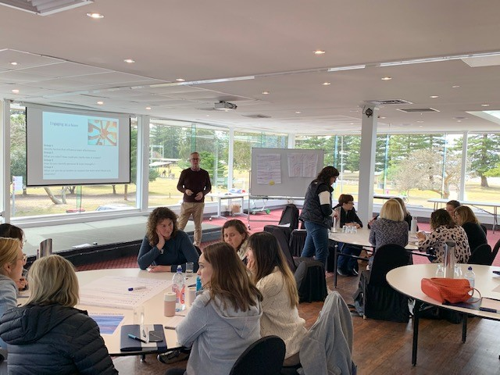
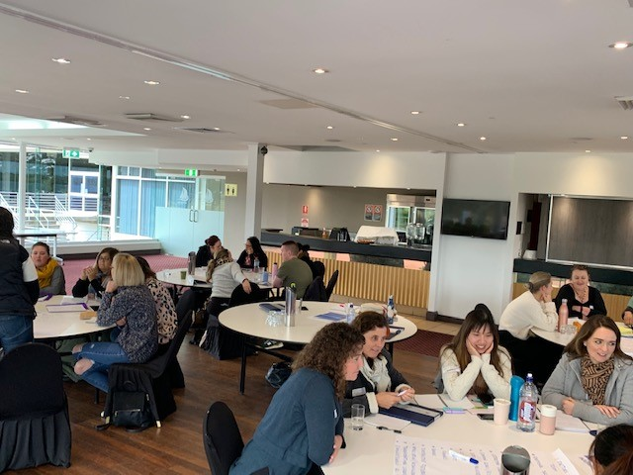

The Leadership Program
The program is delivered in 2 modules
Partnership with South Eastern Sydney Local Health District (SESLHD) and University of Wollongong
Program consists of a series of one day workshops at SESLHD
Has an academic framework with 3 academic assignments in first module
Uses practice development principles to support leadership development
Notes:
The post graduate subject is the first module of a 12 month leadership program, and it was developed in 2007 with a partnership between our district and the University of Wollongong. Initially it was offered to nurses & midwives, but over time this offer was extended to all health care professionals. This provided opportunities for participants to collaborate, learn from each other, and develop networks to build leadership capacity and capability to lead safe and effective patient care.
The program is built on the philosophy that you don’t need positional power to be a leader. Healthcare workers from all disciplines and positions can develop leadership skills to influence the culture of the workplace.
The workshops are a blend of didactic, and experiential learning based on adult learning principles. Participants are exposed to various models of leadership, and leadership theory. They are encouraged to explore their own values and beliefs to discover their own leadership strengths and characteristics.
Formal assessment consists of 3 academic pieces of work and since 2007 almost 500 participants have successfully completed the program.

Slide 6

Effective Leadership in Health
Subject learning outcomes:
Critically appraise the practices that leaders use to facilitate change
Understand and debate the need to clarify personal values in order to lead by example
Critically analyse the skills and qualities needed to inspire a shared vision for change
Critically analyse the factors that help leaders challenge the process
Critically analyse the skills needed to empower others and enable them to act
Critically analyse the factors that contribute to creating a positive working environment
Model the way
Inspire a shared vision
Challenge the process
Enable others to act
Encourage the heart
Notes:
The subject learning outcomes are designed to increase the participants understanding and knowledge of the characteristics of effective leadership within organisational environments in which leaders operate.
Participants are exposed to various theories of leadership and has a focus on understanding self as a leader.
The model of leadership used is The Kouzes & Posner Leadership Challenge . This model uses 5 practices of Leadership , model the way, Inspire a shared vision, challenge the process, enable others to act and encourage the heart. Each practice has two commitments and 10 behaviours that can influence the leadership development.

Slide 7
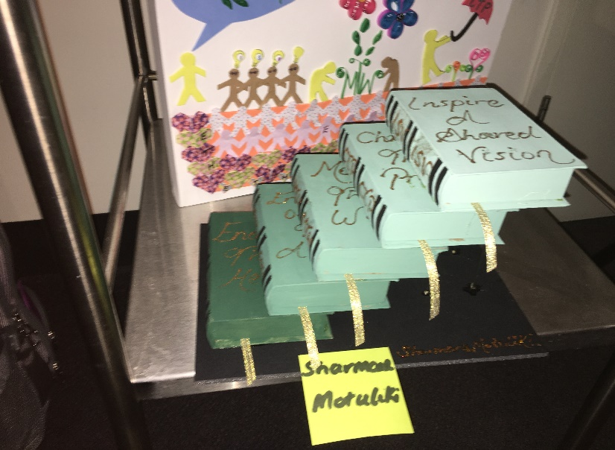
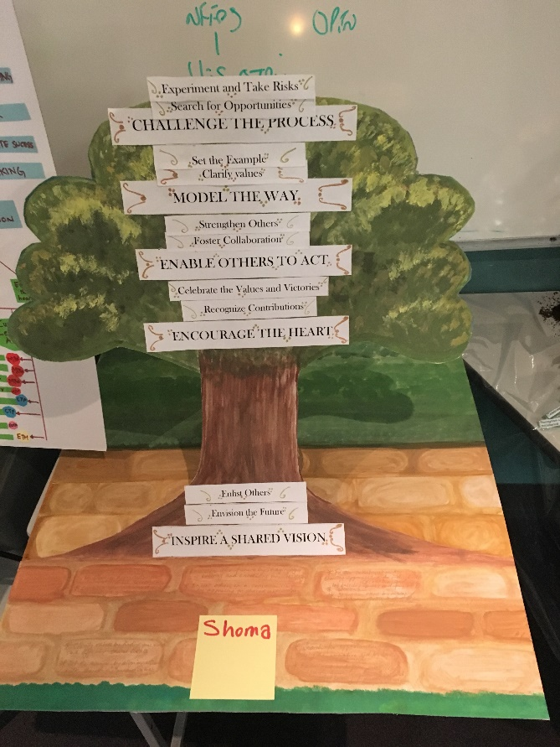


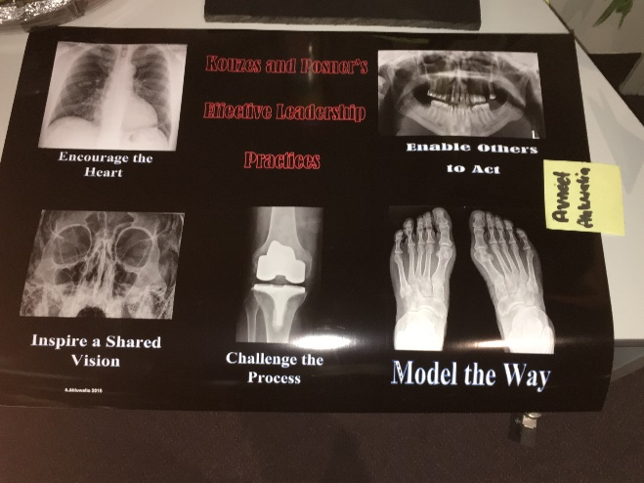
Creativity
Notes:
As the program is quite experiential, one of the ways of enabling participants to think more critically is using creativity. This is one of the practice development principles and evidence suggests that using creativity can bring about transformation individuals and teams that can lead to a more flourishing workplace.
One of the academic assignments uses creativity to enable participants to explore what they’ve learned about themselves as a leader using the Kouzes & Posner leadership practices and behaviours. It also helps them to plan their future leadership development.

Slide 8
Research Methods
Aim: to determine the impact of undertaking a postgraduate leadership subject on current practice in healthcare.
Objectives:
  To investigate the impact of the School of Nursing leadership subject on individuals’ practice up to 2 years after completing the subject.
  To explore how participants who completed the School of Nursing leadership subject up to 2 years previously have applied content and learning to their own leadership and practice.
  To identify strategies that improve articulation of theory to the practice setting by evaluating the learning outcomes and leadership principles from the School of Nursing leadership subject in practice.
Notes:
Now I’ve given you the background to the program the aim of the research was to determine the impact of undertaking a postgraduate subject on current practice in healthcare.
With regards to the objectives of the research a two year time frame was chosen because of recency of completion of the program and participants are more likely to have retained what they learned. They are more able to discuss the impact of what they’ve learned on their practice.
Another objective was to identify strategies of how the leadership theory is transferred into practice and aligned to the identified learning outcomes.

Slide 9
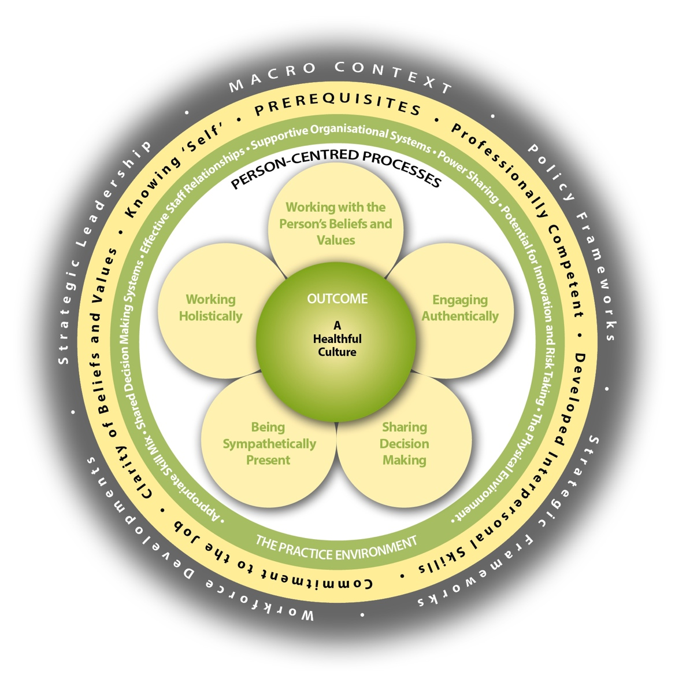
Conceptual approach
Person-centred practice and learning
Based on Person-Centred Practice Framework (McCormack & McCance, 2017)
Focus on person and their connection to others in meaningful ways, underpinned by values of respect for others -> facilitates the learner to authentically consider concept and principles through their lived experience.
McCormack, B. & McCance, T. (2017). Underpinning principles of person-centred practice. In B. McCormack & T. McCance (Eds.), Person-centred practice in nursing and health care. Theory and practice, 2nd edn (pp. 13-35). Oxford, England: Wiley Blackwell.
(McCormack & McCance PCPF revised in press)
Notes:
The conceptual approach to the research was person centred practice and learning based on this Person Centred Framework by Mccormack and McCance . Some of you particularly if you’re from the UK may be familiar with this framework as it’s used quite widely in practice development work. It facilitates the participants to make meaningful connection with others at the micro macro and meso levels in an organisation, and this can influence workplace culture in positive ways..
C

Slide 10
Design
Qualitative descriptive approach
Previous participants invited to participate
Three Local Health Districts
Three Group interviews
  Fifteen participants
  Predominantly nurses (13)
  Other disciplines included (social work, physiotherapist, occupational therapist)
Thematic analysis
Notes:
The design of the research was one of a qualitative study using thematic analysis of the findings.
An expression of interest to be involved in the research was sent out to all past participants of the program in the 3 health districts where the program is delivered, and who had completed the program in the past 2 years. Ethics was approved by the university research committee.
A total of 15 participants agreed to be part of the research. 3 focus groups were held and participants were interviewed and the interviews recorded.
The 3 authors of this study were involved in the thematic analysis. This was done independently then they came together to compare themes from the transcripts of the recorded interviews.

Slide 11
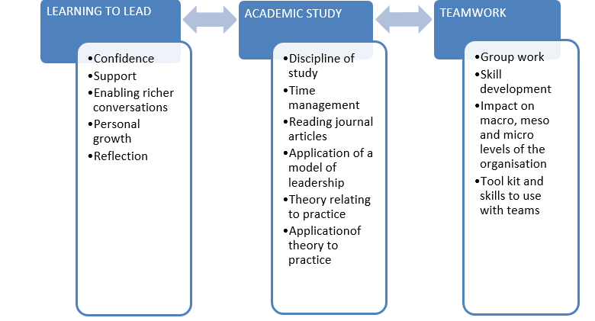
Findings
Notes:
Subcodes were identified from the thematic analysis that you can see here in the boxes, and from these subcodes 3 major themes emerged, Learning to lead, academic study and teamwork. I’m going to talk about these in more detail in the rest of the presentation.

Slide 12

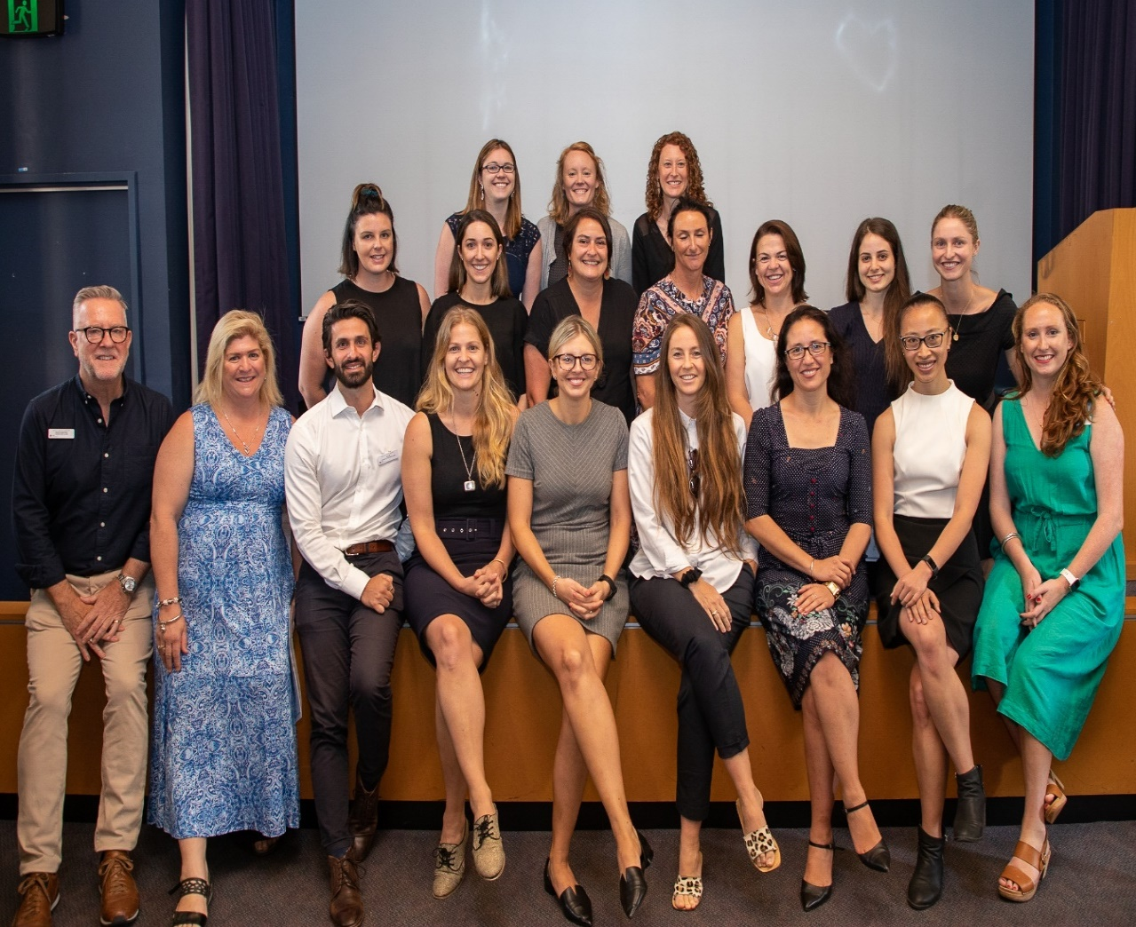
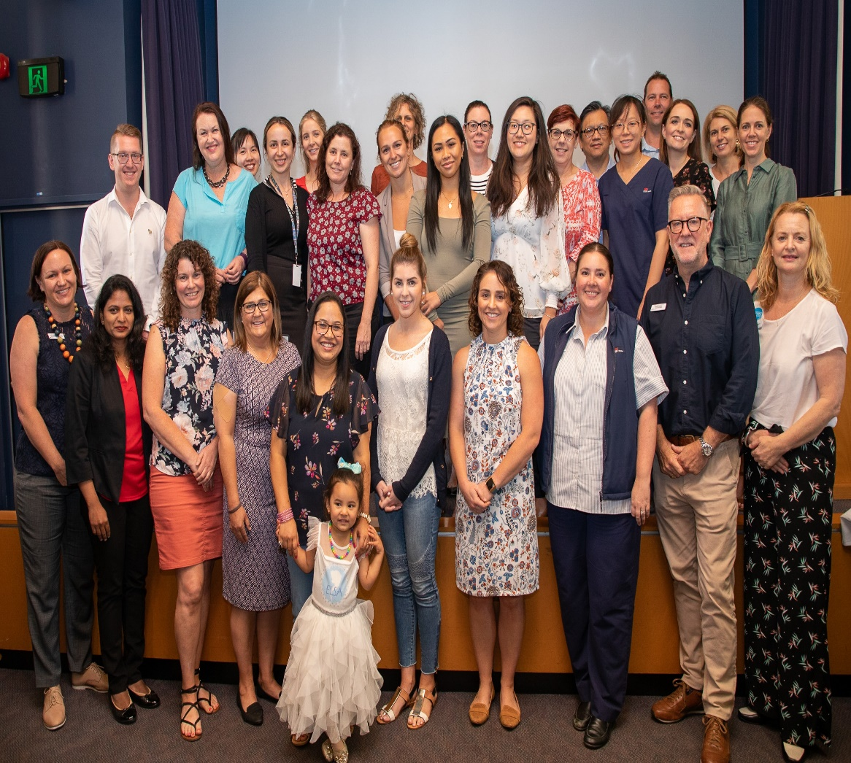
Learning to lead
What better way to hear about what the participants learned about learning to lead than from the participants themselves.
Notes:
What better way to hear about what the participants learned about learning to lead than from the participants themselves.
DON’T READ THE REST!
Not sure yet about the rest of the narrative . Can probably get rid of it.
Participants talked about being exposed to a set of behaviours and tools that supported self development as a leader and equipped them to lead. Participants reported being more aware of self as a leader and how this enabled confidence to be challenged and to take on leadership roles. This included using their voice more proactively .
Increased self-awareness was seen as important because values were identified and understood in relation to others and the organization. Articulation of values helped to influence and support people around them, particularly using strategies from the workshops.
Raised awareness was also discussed in terms of how they listened to others, hearing the intention rather than just words. This enabled richer conversations with colleagues and ability to empower others in the team.
Reflection was noted as key learning by participants. It was noted to facilitate self analysis of behaviours and impact on others. This also helped them to see things differently and then take courage to step outside their comfort zone.

Slide 13

Academic Study
‘I found it helpful in terms of personal and organisational change – the assessments made me do action plans that related to these things.’ (participant 8)
You wanted my opinion supported by theory. You wanted me to think! It made me get into the literature.’ (participant 13).
Enabled deeper learning
  Immersion in literature
  Discussion of theory at workshops
  Challenged by facilitators
  Development of critical thinking
  Helped to translate learning into practice
‘I’m still reading leadership books and researching ideas, especially in terms of inspiring and building capacity from (the) bottom up.’ (participant 12)
Notes:
Participants found the academic study enabled them to learn at a much deeper level. This helped them to retain what they had learned which made it easier to transfer into practice. Once engaged in reading the literature participants reported they could think more critically. The workshops also provide an opportunity where they could have discussions and learn from each other.

Slide 14

Academic Study
Using a model to apply to skill development and change in teams
  ‘So much action occurred once recognition and praise were the norm. We changed processes, we were involved in change management – nurse-led things. Our team started to have solutions as our focus, not problems. We’ve seen massive changes, we’ve had really positive changes to patient outcomes.’ (participant 6)
Learning to lead not manage
  ‘Doing the LPI (Leadership Practices Inventory) - it was so poignant. Actually recognising what my strengths and weaknesses are. This challenged me to be more holistic in my practice, to think about areas I don’t do and question why I don’t do them.’ (participant 7)
Notes:
The level of engagement in learning is evident from these responses from the participants which suggests translation of learning has occurred. I really like the first on so I’ll read it out to you.
So much action occurred once recognition and praise were the norm. We changed processes, we were involved in change management- nurse-led things. Our team started to have solutions as our focus, not problems. We’ve seen massive changes, we’ve had really positive changes to patient care.
This shows a move towards a more of a can do attitude.

Slide 15
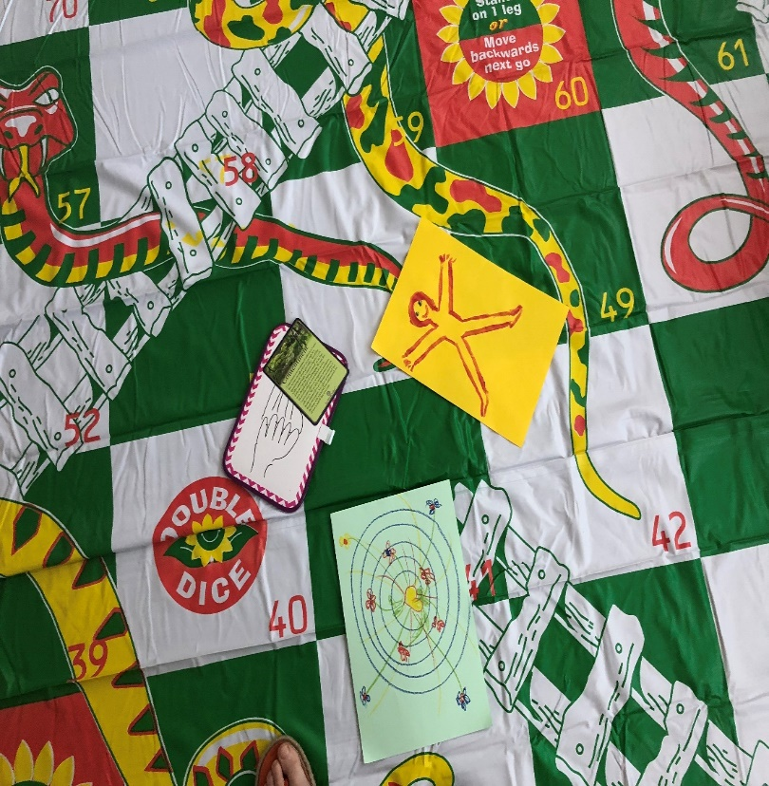
Teamwork
Use of enabling questions -> richer conversations
Listening and using voice -> equipped to engage and lead teams
Giving praise -> teamwork and positive culture
Role modelling and facilitated discussions ->influence, trust, meaningful relationships
  “I’m leading by example. I’m part of the team. The distinction between leadership and management is so profound for me now and I work to be present with my team. It’s made a difference to our relationships. We talk more openly.” (participant 10)
Respecting different perspectives ->involving team members in decisions (sound byte)
Notes:
The third theme that emerged from the study was how participants now engaged as members and leaders of a team. They said they were more confident to speak up and use their voice in their teams in particular giving feedback and praise to colleagues. (play soundbite). They are having more meaningful conversations and involving their team members in decision making. This has an important influence to build trust in teams.(play sound bite).

Slide 16
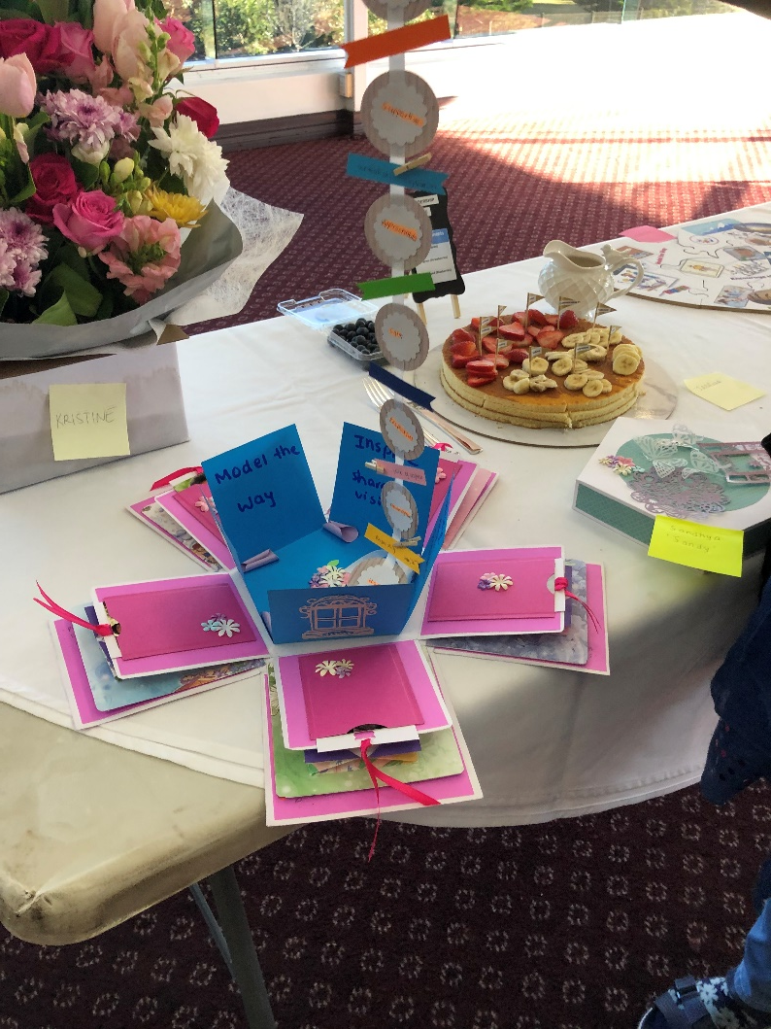

Key Factors
Trust
Broader networking amongst disciplines
Self-awareness
Awareness of others (team and other disciplines)
Awareness of context enhanced
Use of research to inform decisions and priorities
Learning from others.
Formal assessment contributes to learning
Notes:
From these 3 themes in the research some of the key factors that are highlighted are that:-
Trust is engendered when collaboration is fostered amongst healthcare professionals. This leads to cohesions, open discussion, and better healthcare provision
Broader networking amongst many disciplines enables power and influence, to be used to bring about change.
Self-awareness leads to self-development and maturity in responses and actions
Awareness of others (teams and other disciplines) enhances capacity and capability. Behaviours that value and enable others impact service delivery -> people are respected and enabled to be their best
They used research to inform decisions and prioritise.
Learning from others. Physical presence in workshops promotes sharing and mutual understanding, it creates a safe environment to practice behaviours and then take back to workplace
The formal assessments were shown to contribute to learning

Slide 17
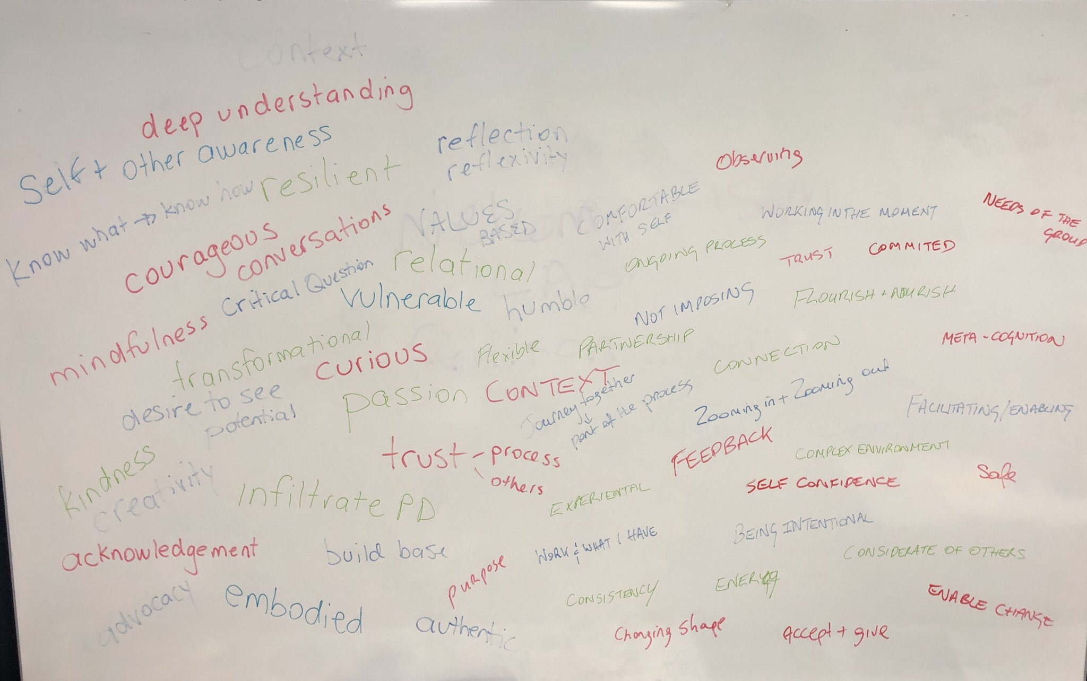

Our learning
Use of leadership model
Translating knowledge and theory to healthcare practice brings about transformation
Collaboration and shared facilitation between academia and local healthcare leaders
  Valued
  Mentioned by participants as contributing to the links
Notes:
The key learnings from the research focused around how using the Kouzes & Posner leadership practices model was really important. This aspect featured prominently in the transcripts, with participants discussing the ongoing use of the practices and behaviours outlined by Kouzes & Posner to support their leadership development.
The partnership between the university and the health districts enabled collaboration and sharing between the two settings. This was really important for the facilitators, but was also reflected by participants as helping them to see the value and linking of knowledge and theory into practice.

Slide 18
Yes!
Leadership education does translate to health practice
“I now have the confidence to speak up more and get involved in discussions in the workshops and in my workplace”
“I learned a lot about myself in the program and then go out into the big wide world as a leader. It gave me confidence plus tools to step into leadership roles:
“I’m not afraid to approach people with my ideas…..to get buy in from people in higher positions. I’m doing this now- I never would have before”
“The same thing keeps coming up, like reflective practice, values clarification, and ways of working. These are principles I have been incorporating into my everyday thinking and how I can use them”
“I’m leading by example. I’m part of the team. The distinction between leadership and management is so profound for me now. I work to be present with my team. It’s made a difference to our relationships . We talk more openly”
Notes:
Have we answered our question Does Leadership Education translate to Health practice? From the findings of the research and the feedback form the interviews of the participants. We say it has!!
There has been personal growth as leaders for the participants. Their behaviours and actions have influence in transforming teams and systems in their workplace.
This can have a positive impact on workplace culture enabling individuals and teams to flourish. If you have a flourishing ward and organisation this can lead to improved care for patients.

Slide 19

Acknowledgements
Keith Jones- Nurse Manager Leadership Initiatives South Eastern Sydney Local Health District keith.jones1@health.nsw.gov.au
Dr. Rebekkah Middleton – Senior Lecturer school of Nursing University of Wollongong rmiddle@uow.edu.au
Margaret Martin Nurse Manager South Eastern Sydney Local Health District Margaret.martin2@health.nsw.gov.au
All the participants that took part in the research
Notes:
Finally I’d like to acknowledge my colleagues and the participants that were involved in the research. This year 2020 is the year of the nurse and midwife and The nightingale challenge has a focus on supporting leadership development for our young emerging leaders. It gives me such great pleasure to be one of the facilitators of this leadership program and I feel very privileged to support leadership development for our nurses and midwives for the future.
Thank You!

